Slide 1


          University of Diyala
          College of Engineering
          Department of Electronics Engineering
Course Number: U103
Course Name: Computer Networks
Lecture (11)
Asst. Lect. Ahmed Mohammed Ahmed

Slide 2
Error detection and correction
Types of Errors
Whenever bits flow from one point to another, they are subject to unpredictable changes because of interference. This interference can change the shape of the signal. The term single-bit error means that only 1 bit of a given data unit (such as a byte, character, or packet) is changed from 1 to 0 or from 0 to 1. The term burst error means that 2 or more bits in the data unit have changed from 1 to 0 or from 0 to 1. Figure 11.1 shows the effect of a single-bit and a burst error on a data unit.

Slide 3
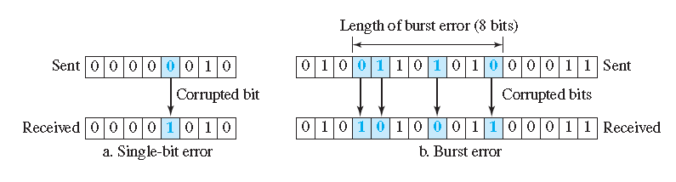

Slide 4
Redundancy
The central concept in detecting or correcting errors is redundancy. To be able to detect or correct errors, we need to send some extra bits with our data. These redundant bits are added by the sender and removed by the receiver. Their presence allows the receiver to detect or correct corrupted bits.

Slide 5
Detection versus Correction
The correction of errors is more difficult than the detection. In error detection, we are only looking to see if any error has occurred. The answer is a simple yes or no. We are not even interested in the number of corrupted bits. A single-bit error is the same for us as a burst error. In error correction, we need to know the exact number of bits that are corrupted and, more importantly, their location in the message. The number of errors and the size of the message are important factors. If we need to correct a single error in an 8-bit data unit, we need to consider eight possible error locations; if we need to correct two errors in a data unit of the same size, we need to consider 28 (permutation of 8 by 2) possibilities. You can imagine the receiver’s difficulty in finding 10 errors in a data unit of 1000 bits.

Slide 6
BLOCK CODING
In block coding, we divide our message into blocks, each of k bits, called data words. We add r redundant bits to each block to make the length n = k + r. The resulting n-bit blocks are called code words. How the extra r bits are chosen or calculated is something we will discuss later. For the moment, it is important to know that we have a set of data words, each of size k, and a set of code words, each of size of n. With k bits, we can create a combination of 2k data words; with n bits, we can create a combination of 2n code words. Since n > k, the number of possible code words is larger than the number of possible data words. The block coding process is one-to-one; the same data word is always encoded as the same codeword. This means that we have 2n − 2k code words that are not used. We call these code words invalid or illegal. The trick in error detection is the existence of these invalid codes. If the receiver receives an invalid codeword, this indicates that the data was corrupted during transmission.

Slide 7
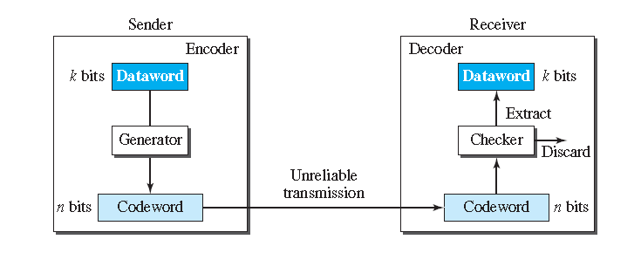

Slide 8
Hamming distance
The Hamming distance between two words is the number of differences between corresponding bits.
The Hamming distance d(000, 011) is 2 because (000 + 011) is 011 (two 1s).
The Hamming distance d(10101, 11110) is 3 because (10101 + 11110) is 01011 (three 1s).

Slide 9
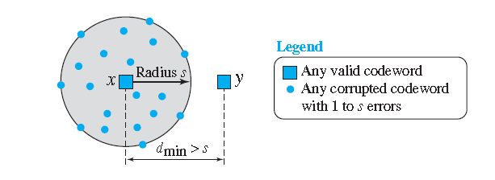
Minimum Hamming Distance for Error Detection
In a set of code words, the minimum Hamming distance is the smallest Hamming distance between all possible pairs of code words. To guarantee the detection of up to s errors in all cases, the minimum Hamming distance in a block code must be dmin=s+1.

Slide 10
Linear block code
A linear block code is a code in which the exclusive OR (addition modulo-2) of two valid code words creates another valid codeword.
Parity-Check Code
Perhaps the most familiar error-detecting code is the parity-check code. This code is a linear block code. In this code, a k-bit data word is changed to an n-bit codeword where n = k + 1. The extra bit, called the parity bit, is selected to make the total number of 1s in the codeword even.

Slide 11
